Slide 1
Job Search

Slide 2
1. CV’s and Resume
Demonstration Statements

Slide 3
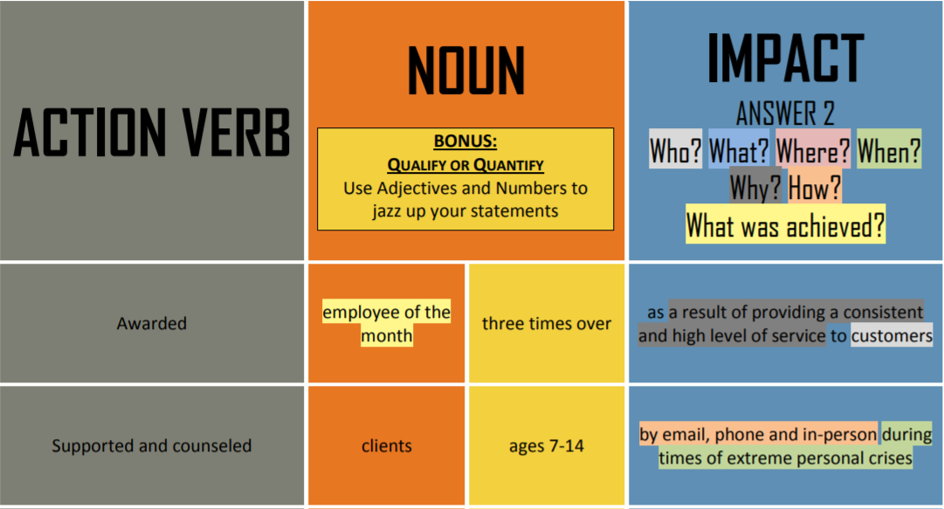
Content Considerations
Show HOW you have demonstrated a skill; don’t just list it.

Slide 4
Language Considerations
Program Coordinator, Elice Neighborhood Association
Collaborated with inner-city youth to develop a cookbook which showcased diverse cultures in a meaningful way
Shift Supervisor, Starbucks Coffee
Led teammates, ensuring all staff are aware of responsibilities and clearly communicating feedback to improve store operations
Communicate compassionately with pediatric patients and parents, supporting families in times of extreme stress
Volunteer, Health Science Centre

Slide 5
2. Job Interviews
Do’s and Don’ts

Slide 6
Preparing for a Job Interview
When should you arrive for the interview?
What should you wear?
How might interviewers interpret your body language?
What questions are you likely to be asked?
How long should your answers be?
How do you know when the interviewer wishes to end the interview?
How can you get the interviewer’s contact information so you can write a follow-up letter?

Slide 7
Preparing for a Job Interview
Study job interviews
Study the organization
What you can offer
Think of your accomplishments and transferable skills
Initial research to common interview questions/style, dress code.
Story of you

Slide 8
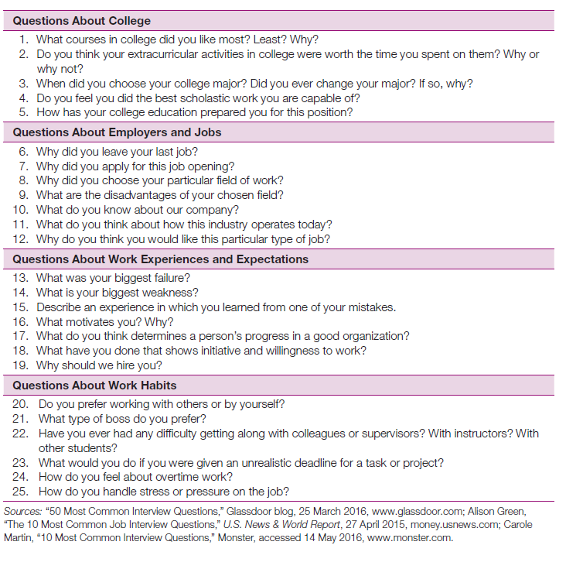
Questions

Slide 9
Planning Questions of Your Own
Interviews are a two-way conversation
Ask insightful questions that showcase your understanding of a position, steer discussion into areas that allow you to prove you are a good fit by presenting your qualifications to your advantage

Slide 10
Additional Tips
Boosting your Confidence
Polishing your Interview Style

Slide 11
Additional Tips
The Warmup
The Question-and-Answer Stage
The Close
Interview Notes

Slide 12
Additional Tips
The first minute of the interview is crucial so stay alert and be on your best business behavior. Make sure you are ready.
Listen carefully to questions before you answer. Paying attention to both verbal and nonverbal messages can help you turn it to your advantage
Law prohibits employment discrimination based on multiple factors. Think about how you would respond if you were asked a potentially discriminatory question.
Conclude an interview with courtesy and enthusiasm. Research salary ranges in your job/industry and geographic region before you try to negotiate salary and benefits.

Slide 14
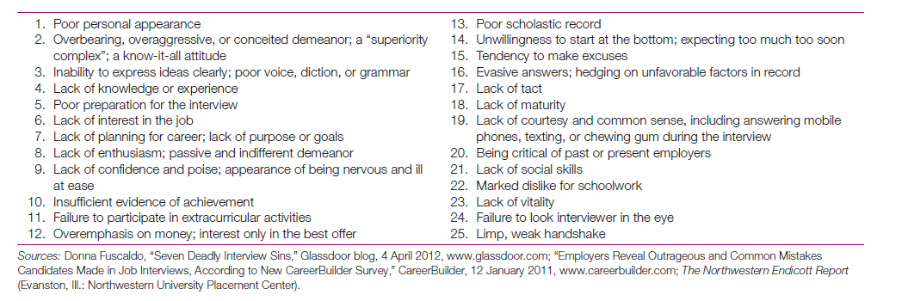
Red Flags for Interviewers

Slide 15
Follow up Correspondence
Follow up Message
Within two days of interview
Reinforce reasons for a good choice, add to interview response or respond to negatives
Message of Inquiry
Use the model for a direct request when you write an inquiry about hiring decision.
Particularly appropriate if you have another job offer awaiting.
Request for a Time Extension
If you are awaiting other interviewing opportunities, request extended time.
Make strong assertive statement and give a dated time to get back to them.

Slide 16
Letters of appreciation after an Interview
Thank the interviewer for taking the time to see you and emphasize your particular qualifications.
Restate interest and mention any specific fact about position or something you found particularly interesting

Slide 17

Letter of Acceptance
If by phone, request a formal acceptance in writing
Respond with a letter or email of acceptance
Accept an offer with enthusiasm
Use the model for positive messages when you write a letter of acceptance.

Slide 18
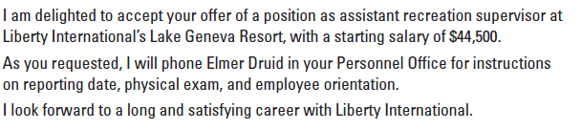

Slide 19

Letter of Refusal
Write a prompt and cordial letter or email
Explain your reasons and allow for future possibilities
Lets the employer know why you have chosen a particular competitor and turned down an offer
If you are declining an offer, do so tactfully, using the model for negative messages.

Slide 20
